Slide 1
Spark Overview
Apache Spark is an open-source distributed general-purpose cluster computing framework. Spark provides high-level APIs in Java, Scala, Python, and R, and an optimized engine that supports general execution graphs. It also supports a rich set of higher-level tools including Spark SQL for SQL and structured data processing, MLlib for machine learning, GraphX for graph processing, and Spark Streaming for stream processing.
Spark is designed to be fast and scalable. It can run on a single machine or on a cluster of machines. Spark is used by a wide variety of organizations, including Netflix, Airbnb, and Yahoo.

Slide 2
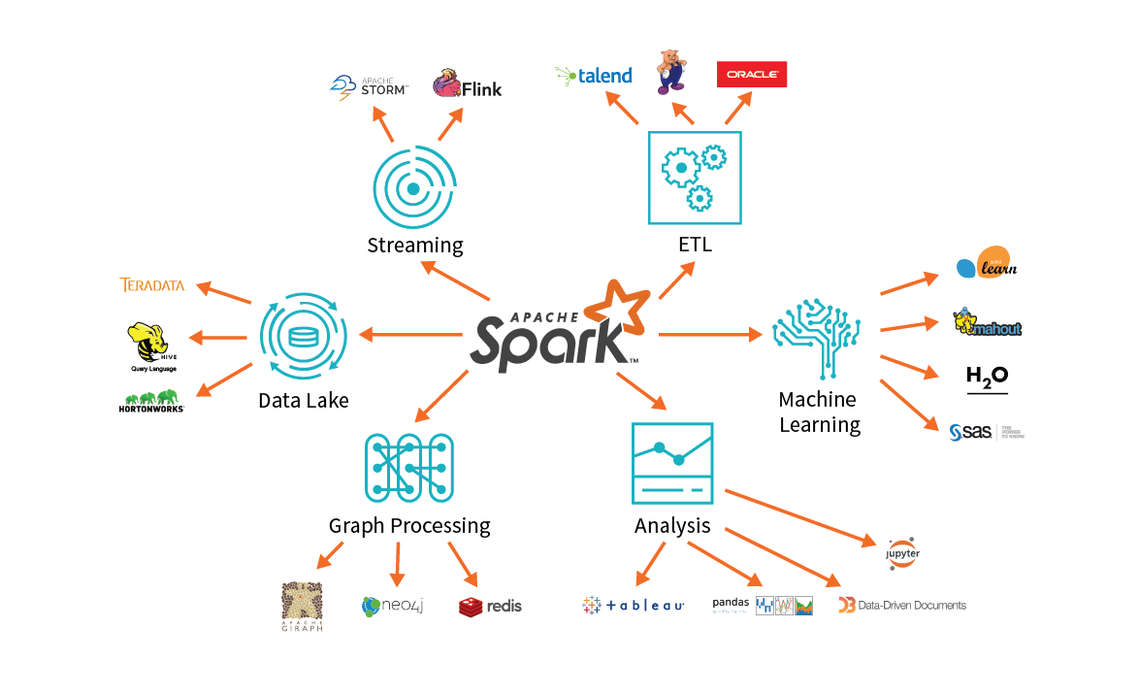
Spark Overview

Slide 3
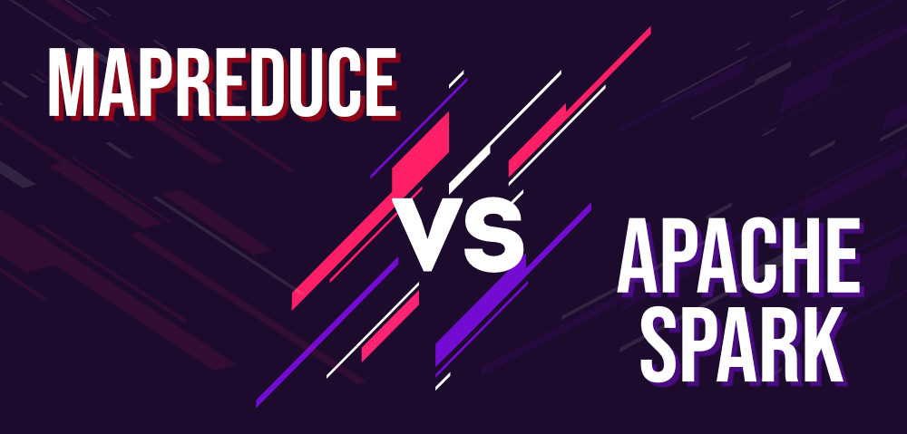
Spark Vs MapReduce

Slide 4
Spark Vs MapReduce
S.No. | MapReduce | Spark
1 | It is a framework that is open-source which is used for writing data into the Hadoop Distributed File System. | It is an open-source framework used for faster data processing.
2 | It is having a very slow speed as compared to Apache Spark. | It is much faster than MapReduce.
3 | It is unable to handle real-time processing. | It can deal with real-time processing.
4 | It is difficult to program as you required code for every process. | It is easy to program.

Slide 5
Spark Vs MapReduce
S.No. | MapReduce | Spark
5 | It supports more security projects. | Its security is not as good as MapReduce and continuously working on its security issues.
6 | For performing the task, It is unable to cache in memory. | It can cache the memory data for processing its task.
7 | Its scalability is good as you can add up to n different nodes. | It is having low scalability as compared to MapReduce.
8 | It actually needs other queries to perform the task. | It has Spark SQL as its very own query language.

Slide 6
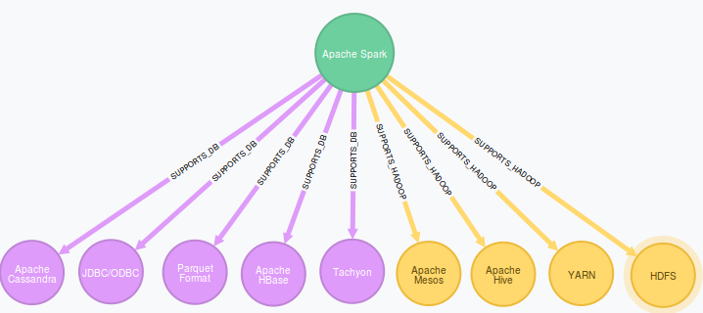
Spark Ecosystem
The Spark Ecosystem is a collection of open-source projects that are built on top of Apache Spark. These projects extend the functionality of Spark and make it easier to use for a variety of tasks.

Slide 7
Spark Ecosystem
Spark SQL: Spark SQL is a module that provides SQL support for Spark. This makes it easy to use Spark for data warehousing and data analytics tasks.
MLlib: MLlib is a module that provides machine learning libraries for Spark. This makes it easy to train and deploy machine learning models on Spark.
GraphX: GraphX is a module that provides graph processing libraries for Spark. This makes it easy to process graphs on Spark.

Slide 8
Spark Ecosystem
Spark Streaming: Spark Streaming is a module that provides streaming processing capabilities for Spark. This makes it easy to process data streams in real time.
Delta Lake: Delta Lake is a project that provides a unified data lake storage layer for Spark. This makes it easy to manage and query data in a data lake.

Slide 9
Spark Architecture
Spark architecture consists of four components, including the spark driver, executors, cluster administrators, and worker nodes. It uses the Dataset and data frames as the fundamental data storage mechanism to optimise the Spark process and big data computation.

Slide 10
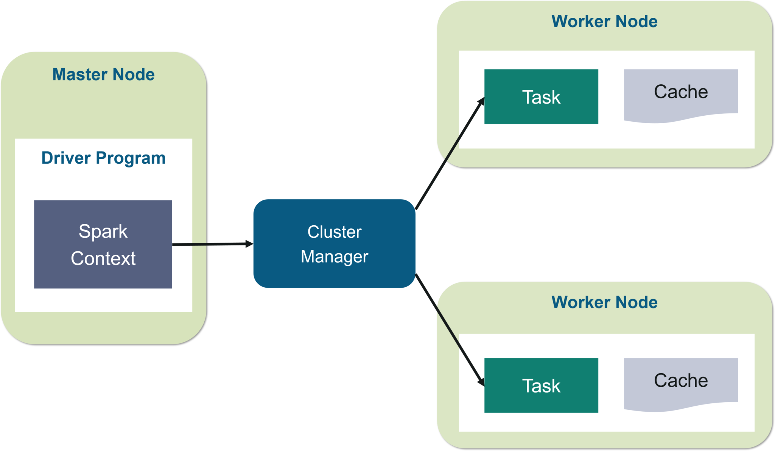
Spark Architecture

Slide 11
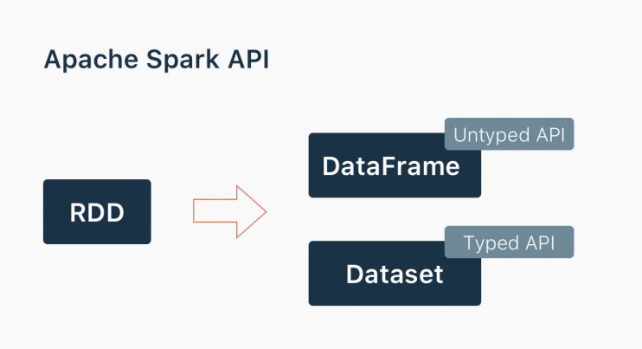
Spark APIs
Spark provides APIs in four programming languages: Java, Scala, Python, and R.

Slide 12
Spark APIs
Java API: The Java API is the most mature API of Spark. It is designed to be easy to use for Java developers.
Scala API: The Scala API is a superset of the Java API. It provides additional features that are not available in the Java API.
Python API: The Python API is designed to be easy to use for Python developers. It is a thin wrapper around the Java API.
R API: The R API is designed to be easy to use for R developers. It is a thin wrapper around the Java API.
The Spark APIs are all similar in terms of their functionality. They all provide the same basic operations for creating RDDs, running jobs, and accessing data.

Slide 13
Spark Installation
Steps for Installation:
Download Apache Spark:
Go to the official Apache Spark download page: https://spark.apache.org/downloads.html
Choose the latest Spark release and download the pre-built package for your desired Hadoop version (e.g., "Spark x.y.z (Hadoop x.y)").
Extract the downloaded tarball to your preferred location.

Slide 14
Spark Installation
Set Environment Variables (optional but recommended):
Open your shell profile configuration file (e.g., ~/.bashrc, ~/.zshrc).
Add the following lines to set Spark-related environment variables:
export SPARK_HOME=/path/to/spark-<version>
export PATH=$SPARK_HOME/bin:$PATH
Replace /path/to/spark-<version> with the actual path to your Spark installation.

Slide 15
Spark Installation
Configuration:
Spark configuration settings are typically stored in the spark-defaults.conf and spark-env.sh files within the conf directory of your Spark installation. You may need to adjust these files to suit your specific requirements.

Slide 16
Spark Installation
Start a Spark Cluster (Standalone Mode):
You can start a local Spark cluster for testing and development purposes using the following command:
$SPARK_HOME/sbin/start-all.sh
This command starts the master and worker nodes on your local machine.

Slide 17
Spark Installation
Verify Installation:
Open a terminal and run the following command to open the Spark shell:
Spark-shell
You should see the Spark shell prompt, indicating that Spark is running.

Slide 18
Spark Installation
Stop the Spark Cluster (Standalone Mode):
After you're done using Spark, you can stop the local cluster using the following command:
$SPARK_HOME/sbin/stop-all.sh

Slide 19
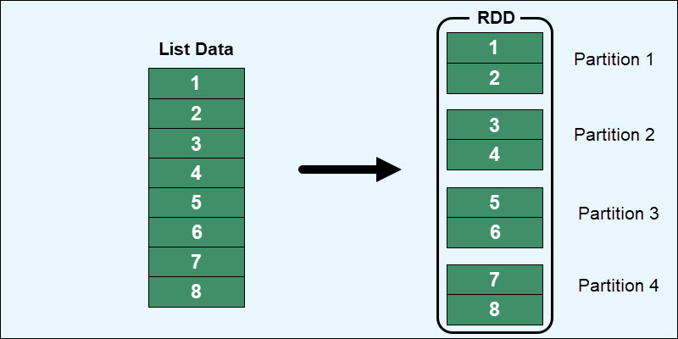
Introduction to Spark RDDs
RDD (Resilient Distributed Dataset) is the fundamental data structure of Apache Spark which are an immutable collection of objects which computes on the different node of the cluster. Each and every dataset in Spark RDD is logically partitioned across many servers so that they can be computed on different nodes of the cluster.

Slide 20
Introduction to Spark RDDs
Decomposing the name RDD:
Resilient, i.e. fault-tolerant with the help of RDD lineage graph(DAG) and so able to recompute missing or damaged partitions due to node failures.
Distributed, since Data resides on multiple nodes.
Dataset represents records of the data you work with. The user can load the data set externally which can be either JSON file, CSV file, text file or database via JDBC with no specific data structure.

Slide 21
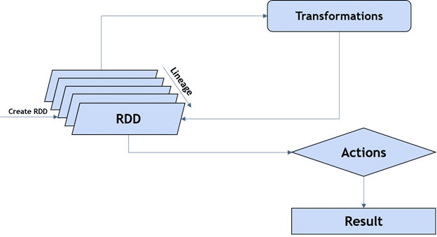
Creating RDDs

Slide 22
Creating RDDs
Parallelize an existing collection: This is the simplest way to create an RDD. You can use the parallelize() function to create an RDD from an existing collection, such as a list or a set.
rdd = sc.parallelize([1, 2, 3, 4, 5])
Load a file: You can use the textFile() function to create an RDD from a file. The textFile() function takes the path to the file as its argument.
rdd = sc.textFile("data.txt")

Slide 23
Creating RDDs
Create an empty RDD: You can use the emptyRDD() function to create an empty RDD.
rdd = sc.emptyRDD()
Create an RDD from another RDD: You can use the map() function to create an RDD from another RDD. The map() function takes a function as its argument. The function is applied to each element of the RDD and the results are collected into a new RDD.
rdd = sc.parallelize([1, 2, 3, 4, 5])
rdd2 = rdd.map(lambda x: x * 2)

Slide 24
Creating RDDs
Create an RDD from a database: You can use the read() function to create an RDD from a database. The read() function takes the JDBC URL to the database as its argument.
rdd = sc.read("jdbc:mysql://localhost:3306/db", "table")

Slide 25
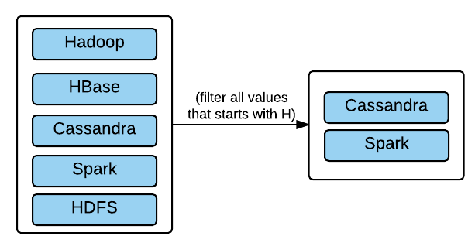
Operations on RDDs
Transformations: Transformations are operations that create new RDDs from existing RDDs. Some common transformations include map, filter, and reduce.

Slide 26
Operations on RDDs
Actions: Actions are operations that return a value from an RDD. Some common actions include count, reduce, and collect.
count(): Returns the number of elements in an RDD.
reduce(): Reduces the elements of an RDD to a single value using a binary function.
collect(): Returns all of the elements in an RDD as a list.
take(): Returns the first n elements of an RDD.
takeOrdered(): Returns the first n elements of an RDD in sorted order.
saveAsTextFile(): Saves an RDD to a text file.
saveAsSequenceFile(): Saves an RDD to a sequence file.

Slide 27
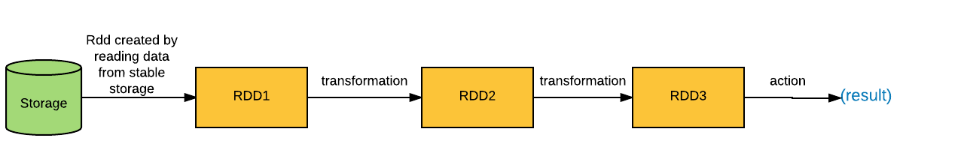
Operations on RDDs
Lazy evaluation: RDDs are lazily evaluated, which means that they are not evaluated until they are needed. This makes RDDs more efficient to work with, as they are only evaluated once, even if they are used multiple times.

Slide 28

Polling Questions
What is Apache Spark primarily used for?
a. Social networking
b. E-commerce
c. Big data processing
d. Image recognition
In comparison to MapReduce, what advantage does Spark offer in terms of data processing?
a. Slower data processing
b. Real-time processing capabilities
c. Simplicity of programming
d. Reduced hardware requirements
Which component of the Spark ecosystem provides a distributed file system for data storage?
a. Spark MLlib
b. Spark SQL
c. Spark Streaming
d. Spark Hadoop Distributed File System (HDFS)

Slide 29
Polling Questions
What is Apache Spark primarily used for?
a. Social networking
b. E-commerce
c. Big data processing
d. Image recognition
In comparison to MapReduce, what advantage does Spark offer in terms of data processing?
a. Slower data processing
b. Real-time processing capabilities
c. Simplicity of programming
d. Reduced hardware requirements
Which component of the Spark ecosystem provides a distributed file system for data storage?
a. Spark MLlib
b. Spark SQL
c. Spark Streaming
d. Spark Hadoop Distributed File System (HDFS)

Slide 30
Polling Questions
What is the primary purpose of installing Spark dependencies like Hadoop or YARN?
a. To improve Spark's in-memory processing speed
b. To enable Spark to work with distributed data storage systems
c. To add machine learning capabilities to Spark
d. To install Spark on Windows operating systems
Which of the following best describes the fault-tolerance feature of RDDs?
a. RDDs are immune to all types of errors.
b. RDDs can recover from node failures and data loss automatically.
c. RDDs never experience data loss.
d. RDDs are backed up in real-time to prevent data loss.
Which of the following operations does not create an RDD?
a. textFile()
b. map()
c. filter()
d. collect()

Slide 31
Polling Questions
What is the primary purpose of installing Spark dependencies like Hadoop or YARN?
a. To improve Spark's in-memory processing speed
b. To enable Spark to work with distributed data storage systems
c. To add machine learning capabilities to Spark
d. To install Spark on Windows operating systems
Which of the following best describes the fault-tolerance feature of RDDs?
a. RDDs are immune to all types of errors.
b. RDDs can recover from node failures and data loss automatically.
c. RDDs never experience data loss.
d. RDDs are backed up in real-time to prevent data loss.
Which of the following operations does not create an RDD?
a. textFile()
b. map()
c. filter()
d. collect()

Slide 32
Summary
Apache Spark is a powerful, open-source, distributed computing system.
RDD stands for Resilient Distributed Dataset, a fundamental data structure in Spark.
RDDs can be created by parallelizing a collection of data in memory or by loading data from external storage like HDFS or local files.
RDD operations are categorized as transformations and actions.
Transformation operations like map, filter, and reduceByKey create new Action operations like count, collect, and reduce return values or save data to external storage.
Spark employs lazy evaluation, meaning transformations are not executed immediately upon definition.

